Slide 1

Smart attendance system
Team gt

Slide 2
abstract
To maintain the attendance record with day to day activities is a challenging task. The conventional method of calling name of each student is time consuming and there is always a chance of proxy attendance. The following system is based on face recognition to maintain the attendance record of students. We have used face detection techniques to develop this system, viola jones object detection method is used to detect faces in images and we compute and compare feature facial of students to recognize them. Our system is capable to identify multiple faces in real time.

Slide 3
introduction
Every organization such as school or college requires a robust and stable system to record the attendance of their students. and every organization have their own method to do so, some are taking attendance manually with a sheet of paper by calling their names during lecture hours and some have adopted biometrics system such as RFID card reader mark the attendance. The conventional method of calling the names of students manually is time consuming event.
Use of face recognition for the purpose of attendance marking is the smart way of attendance management system. Face recognition is more accurate and faster technique among other techniques and reduces chance of proxy attendance. Face recognition provide passive identification that is a person which is to be identified does not to need to take any action for its identity

Slide 4

Work flow
Test image
Pre processing
Feature extraction
Updating in website and database
Marking attendance
Image matching
Stored image Database

Slide 5
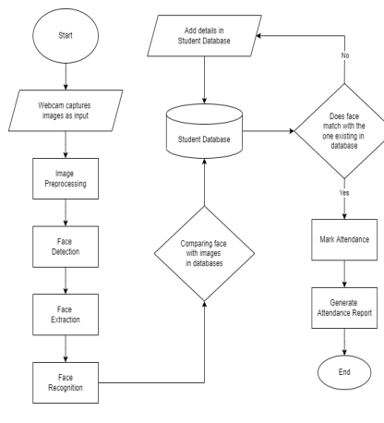

Slide 6
methodology
Image acquisition: Image is acquire using a high definition camera which is placed in the classroom. This image is given as an input to the system.
Dataset Creation: Dataset of students is created before the recognition process. Dataset was created only to train this system. We have created a dataset of students which involves their name, roll number, department and images of student in different poses and variations. Whenever we register student’s data and images in our system to create dataset, deep learning applies to each face to compute rgb facial features and gets encoded and that face is recalled during recognition process. This process is applies to each image taken during registration.

Slide 7
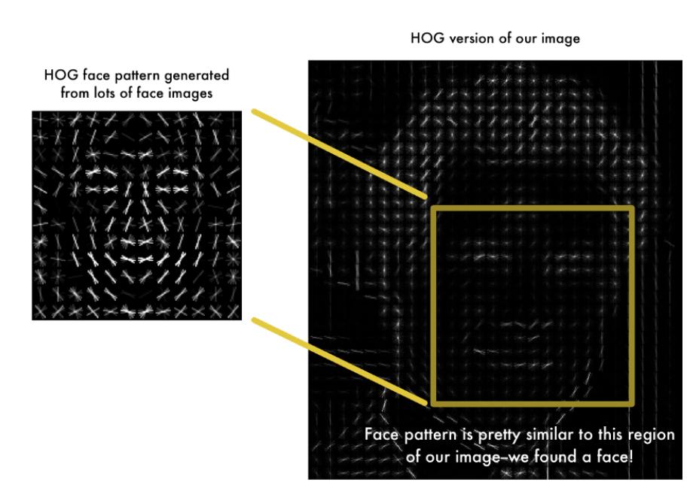
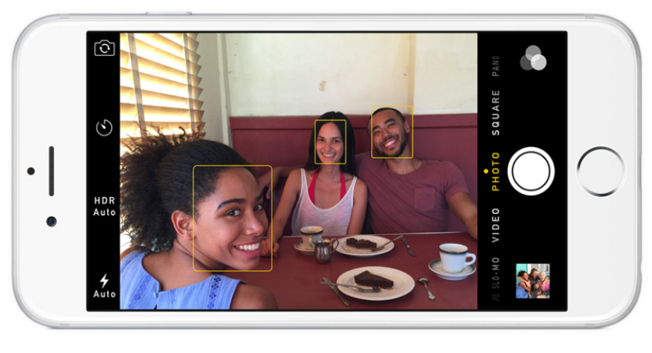
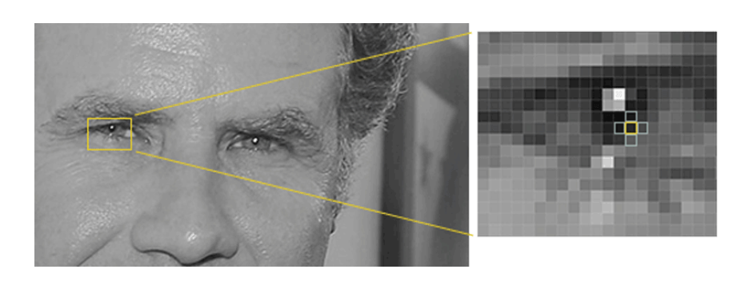
Storing: We have used MYSQL to store the student’s data.
Face Detection and Extraction: Face detection is important as the image taken through the camera given to the system, face detection algorithm applies to identify the human faces in that image, the number of image processing algorithms are introduce to detect faces in an images and also the location of that detected faces. We have used HOG method method to detect human faces in given image. To find faces in an image, we’ll start by making our image black and white because we don’t need color data to find faces. Then we’ll look at every single pixel in our image one at a time. For every single pixel, we want to look at the pixels that directly surrounding it

Slide 8
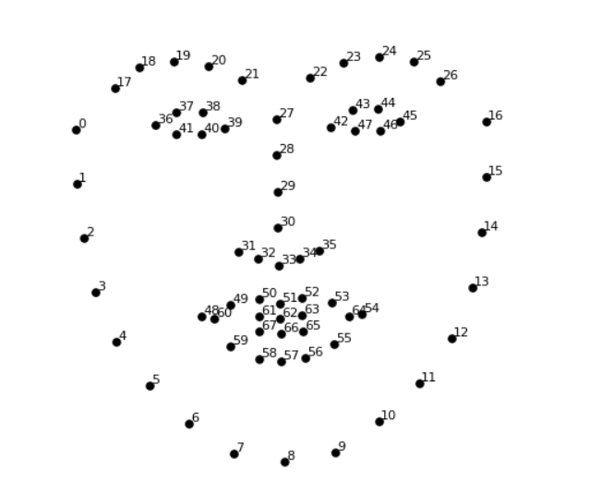
Face Positioning: There are 68 specific points in a human face. In other words we can say 68 face landmarks. The main function of this step is to detect landmarks of faces and to position the image. A python script is used to automatically detect the face landmarks and to position the face as much as possible without distorting the image.

Slide 9
Image encoding
we make a classifier that can take in the measurements from a new test image and tells which known person is the closest match. Running this classifier takes milliseconds. The result of the classifier is the name of the person!

Slide 10
Attendance marking
Once the face is identify with the image stored in data base file, python generate names of present students and return that, when data is returned, the system generates attendance table which includes the name, roll number, date, day and time with corresponding subject id. And then passes the data to python to store the table into an excel sheet as well as stored in attendance database automatically. Each sheet is saved according to the subjects which already entered by the administrator

Slide 11
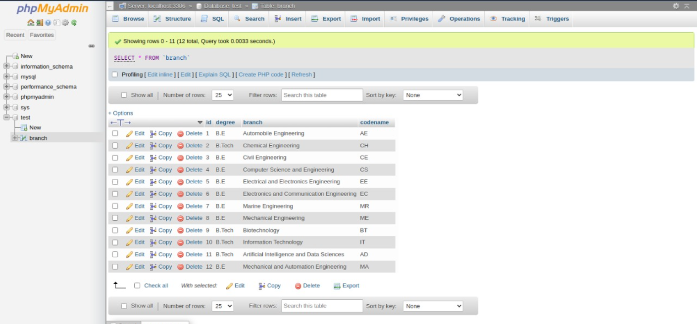
Database schema

Slide 12
Face recognition implementation
OPEN CV OpenCV is a library of programming functions mainly aimed at real-time computer vision. Originally developed by Intel, it was later supported by Willow Garage then Itseez. The library is cross-platform and free for use under the open-source Apache 2 License
PYCHARM it is a free source python IDE

Slide 13
Database implementaion
MYSQL MySQL is an open-source relational database management system. Its name is a combination of "My", the name of co-founder Michael Widenius's daughter My, and "SQL", the abbreviation for Structured Query Language
PHP MYADMIN phpMyAdmin is a free and open source administration tool for MySQL

Slide 14
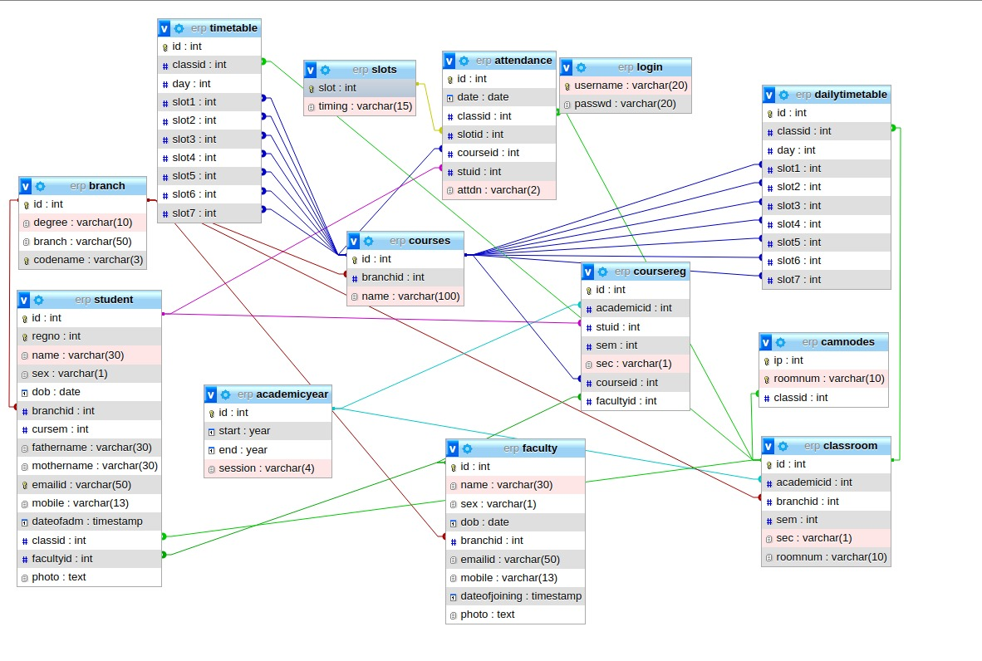

Slide 15

DESKTOP APPLICATION
JavaFX is a software platform for creating and delivering desktop applications, as well as rich web applications that can run across a wide variety of devices. JavaFX has support for desktop computers and web browsers on Microsoft Windows, Linux, and macOS, as well as mobile devices running iOS and Android

Slide 16

Jdbc (java database connectivity)
Java Database Connectivity is an application programming interface for the programming language Java, which defines how a client may access a database. It is a Java-based data access technology used for Java database connectivity. It is part of the Java Standard Edition platform, from Oracle Corporation

Slide 17
Future implementation
Some Development that we want to make sure of is the system’s complete automation. To avoid any discrepancies, such as tampering with the devices, the system must currently be supervised. Our goal is to completely automate the process by using a real-time live feed captured by a CCTV camera to mark students’ attendance without the need for manual supervision, resulting in legitimate and untampered attendance reports.

Slide 18
conclusion
Smart attendance management system is designed to solve the issues of existing manual systems. We have used face recognition concept to mark the attendance of student and make the system better. The system performs satisfactory in different poses and variations. In future this system need be improved because these system sometimes fails to recognize students from some distance, also we have some processing limitation, working with a system of high processing may result even better performance of this system.

Slide 19
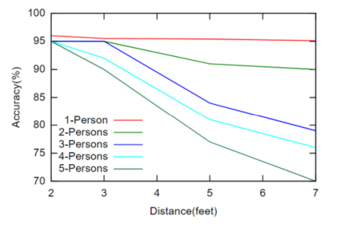
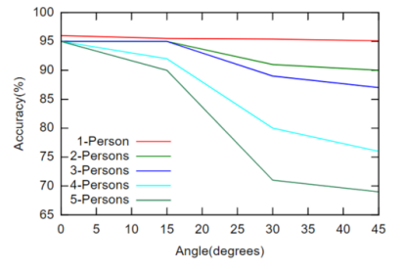
observations

Slide 20
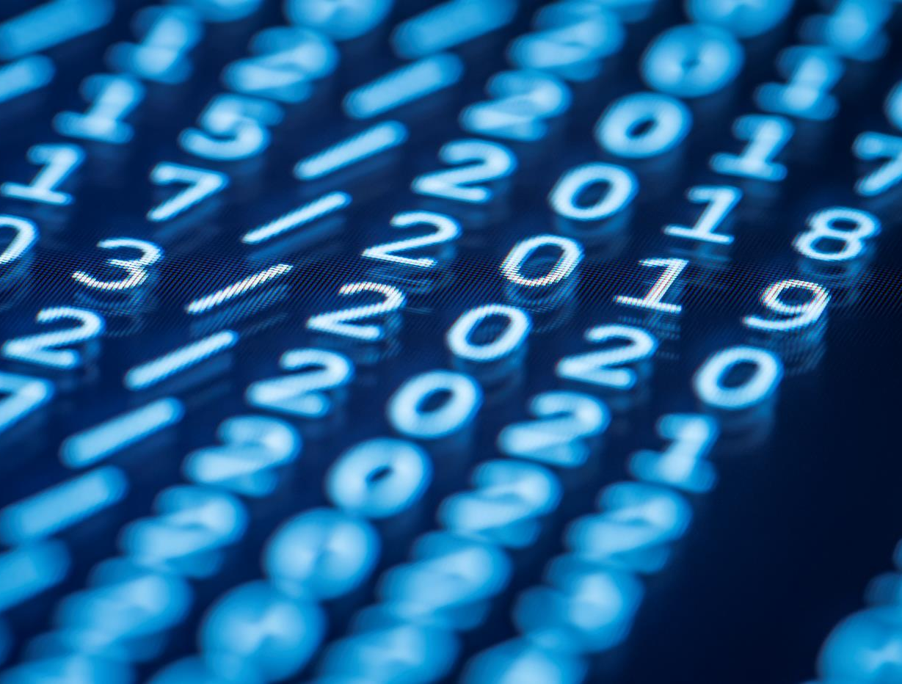
Thank You
1.Parvesh r 2.ram solaiappan a 3.stany romero s 4.mohan raj r

